Slide 1
Agenda,
Current ATP Calibration from Production Instructions below, appears to be a single point Offset adjustment, the Span appears to be hard-coded, set to -1.00.
Calibrating the Laser
Follow the Setup instructions.
Verify the 3-1184-300 oil level sensor is selected and click the Laser Offset button. This opens the Laser Offset window.
Measure the oil level.
Click the Set Oil Level for Changing Offset button and type in the measured oil level.
Click the Change Laser Offset button.
Close the Laser Offset window.
The LK 507 Laser is spec’e as Linearity 0.02% of FS or .004” Keyence Tech Support told me to use .250mm as Absolute accuracy or 0.010” but repeatedly is 2um or .00008”
Based on the above spec, it appears a multi-point calibration would be required.
Perform a Gage R&R using the PWC analysis spreadsheet.
How Level calibration and verification are managed.
Should the laser be in the instrument calibration schedule?
Note: Span = Slope = M while Offest = intercept = B as in y = Mx +B

Slide 2
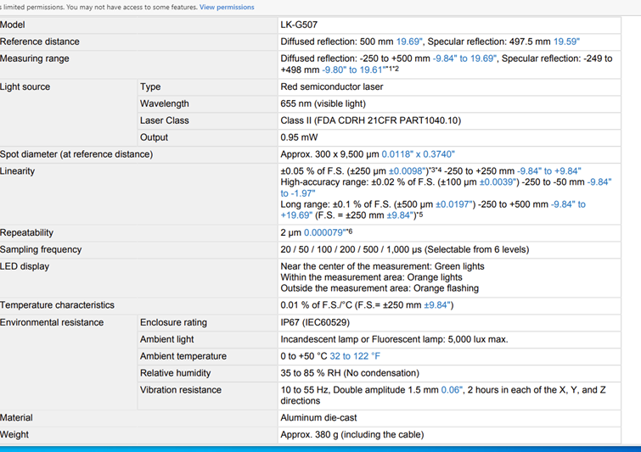
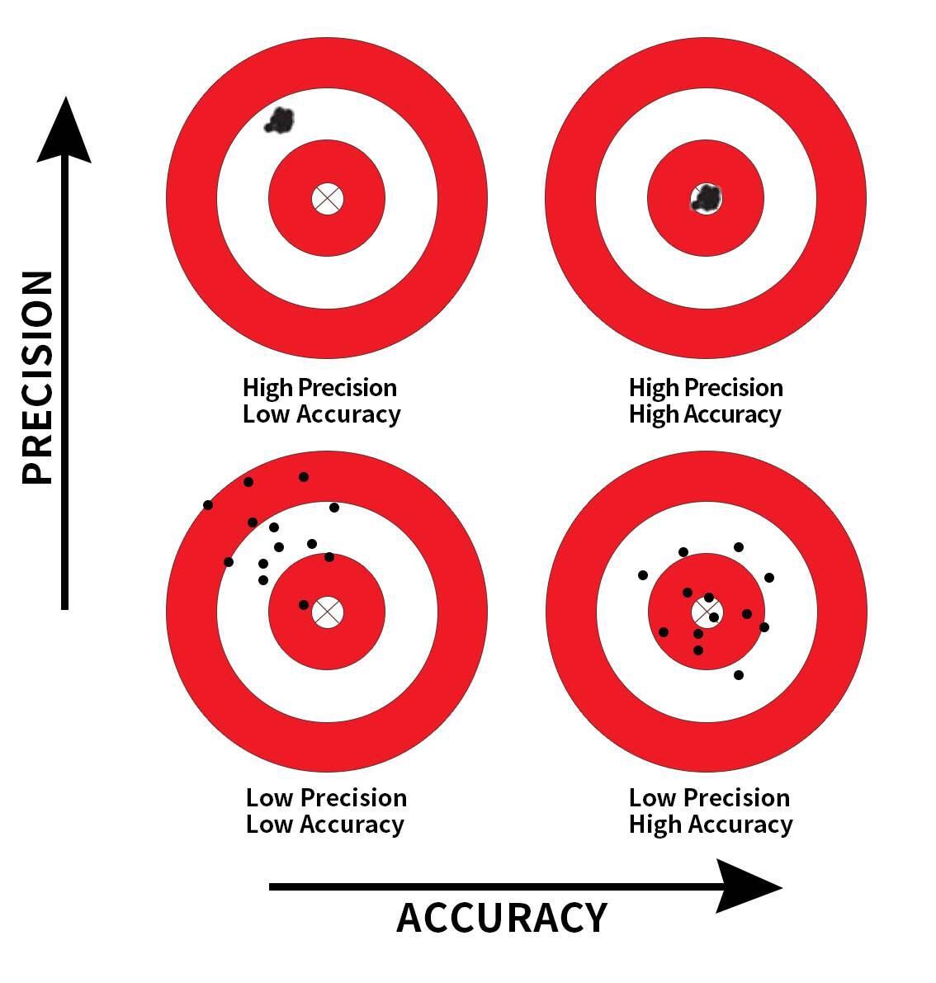
Laser
Depth Mic

Slide 3





Offset Correction
Offset Correction 1
Reproducibility
Offset Correction 2

Slide 4
Offset Correction
Best Fit LSR
Span & Offset Correction
Linear Interpolation Correction
Temperature Characteristics %FS / ᵒC

Slide 5
Offset Correction
Span & Offset Correction

